Slide 1
SOFTWARE CONSTRUCTION : LAB # 10
Queues and message passing, Locks and synchronization & its implementation

Slide 2
Queues and Message Passing in Python
Introduction:
Queues and message passing are essential concepts in concurrent programming, enabling efficient communication between different parts of a system. In Python, these mechanisms are crucial for managing concurrency and ensuring data integrity.

Slide 3

QUEUES:
Definition:
A queue is a data structure that follows the First-In-First-Out (FIFO) principle.
In Python, the queue module provides a versatile Queue class for implementing queues.
Application:
Use cases include task scheduling, job distribution, and managing resources in a multithreaded or multiprocessing environment.
Implementation:
Example using the queue module:

Slide 4
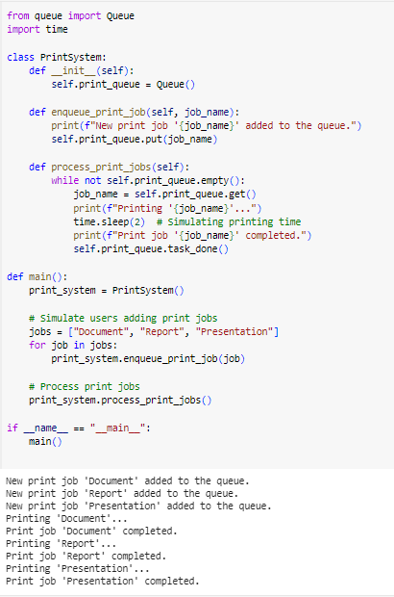
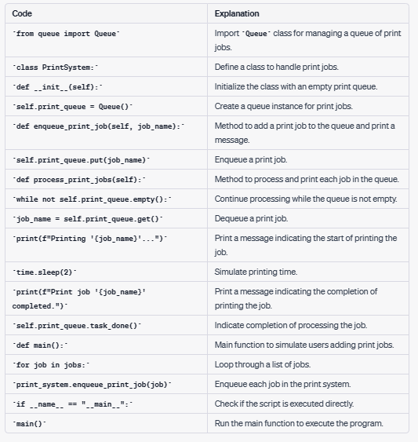
Implementation of queues:
Notes:
from queue import Queue
import time
class PrintSystem:
def __init__(self):
self.print_queue = Queue()
def enqueue_print_job(self, job_name):
print(f"New print job '{job_name}' added to the queue.")
self.print_queue.put(job_name)
def process_print_jobs(self):
while not self.print_queue.empty():
job_name = self.print_queue.get()
print(f"Printing '{job_name}'...")
time.sleep(2) # Simulating printing time
print(f"Print job '{job_name}' completed.")
self.print_queue.task_done()
def main():
print_system = PrintSystem()
# Simulate users adding print jobs
jobs = ["Document", "Report", "Presentation"]
for job in jobs:
print_system.enqueue_print_job(job)
# Process print jobs
print_system.process_print_jobs()
if __name__ == "__main__":
main()

Slide 5
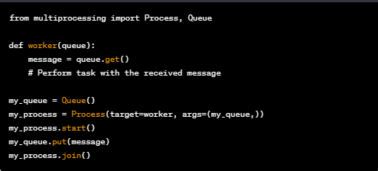
MESSAGE PASSING:
Definition:
Message passing involves communication between different processes or threads through the exchange of messages.
Application:
Ideal for scenarios where different components need to share information without direct dependencies.
Implementation:
Python's multiprocessing module facilitates message passing between processes.

Slide 6
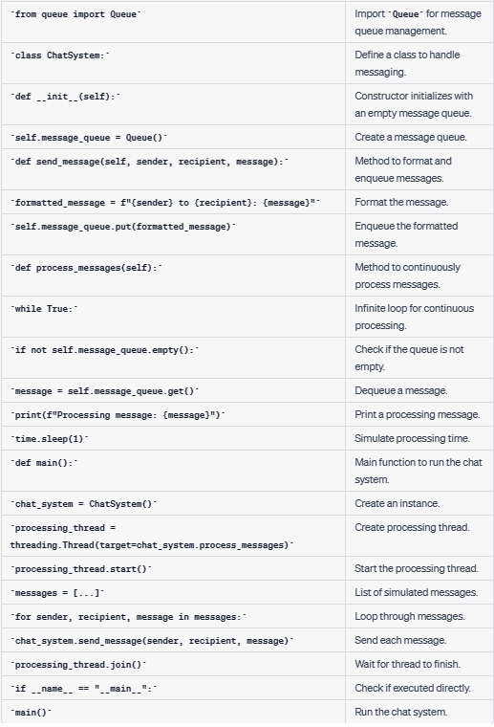
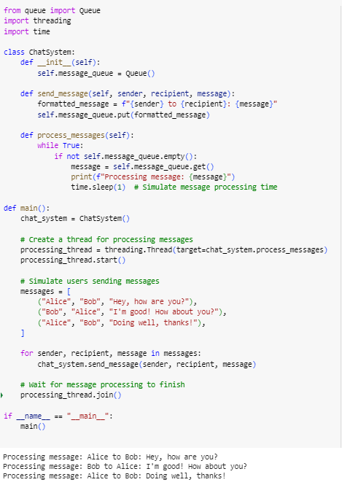
Implementation of message passing
Notes:
from queue import Queue
import threading
import time
class ChatSystem:
def __init__(self):
self.message_queue = Queue()
def send_message(self, sender, recipient, message):
formatted_message = f"{sender} to {recipient}: {message}"
self.message_queue.put(formatted_message)
def process_messages(self):
while True:
if not self.message_queue.empty():
message = self.message_queue.get()
print(f"Processing message: {message}")
time.sleep(1) # Simulate message processing time
def main():
chat_system = ChatSystem()
# Create a thread for processing messages
processing_thread = threading.Thread(target=chat_system.process_messages)
processing_thread.start()
# Simulate users sending messages
messages = [
("Alice", "Bob", "Hey, how are you?"),
("Bob", "Alice", "I'm good! How about you?"),
("Alice", "Bob", "Doing well, thanks!"),
]
for sender, recipient, message in messages:
chat_system.send_message(sender, recipient, message)
# Wait for message processing to finish
processing_thread.join()
if __name__ == "__main__":
main()

Slide 7
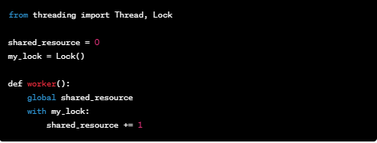
LOCKS IN CONCURRENT PROGRAMMING:
Introduction:
Locks and synchronization mechanisms are crucial for preventing data corruption and maintaining consistency in multithreaded environments.
Locks:
Definition:
A lock is a synchronization primitive used to control access to a shared resource by multiple threads.
Application:
Prevents race conditions and ensures exclusive access to critical sections of code.
Implementation:
Example using the threading module:

Slide 8
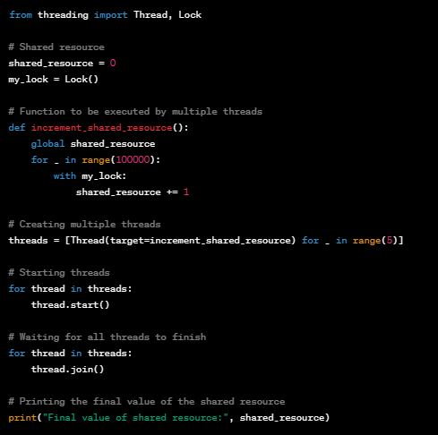
SYNCHRONIZATION:
Definition:
Synchronization ensures orderly execution of threads, preventing conflicts and maintaining program integrity.
Application:
Critical for scenarios where multiple threads interact with shared data.

Slide 9
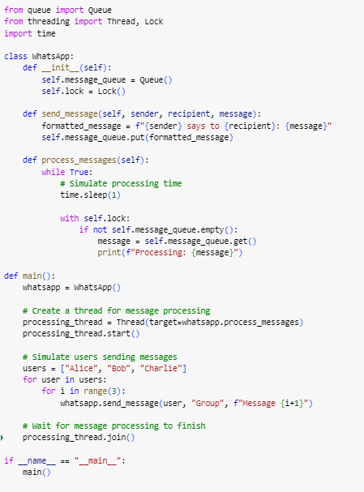
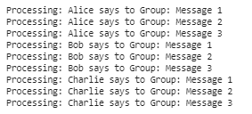
Real life example of a WhatsApp messaging scenario:
Notes:
from queue import Queue
from threading import Thread, Lock
import time
class WhatsApp:
def __init__(self):
self.message_queue = Queue()
self.lock = Lock()
def send_message(self, sender, recipient, message):
formatted_message = f"{sender} says to {recipient}: {message}"
self.message_queue.put(formatted_message)
def process_messages(self):
while True:
# Simulate processing time
time.sleep(1)
with self.lock:
if not self.message_queue.empty():
message = self.message_queue.get()
print(f"Processing: {message}")
def main():
whatsapp = WhatsApp()
# Create a thread for message processing
processing_thread = Thread(target=whatsapp.process_messages)
processing_thread.start()
# Simulate users sending messages
users = ["Alice", "Bob", "Charlie"]
for user in users:
for i in range(3):
whatsapp.send_message(user, "Group", f"Message {i+1}")
# Wait for message processing to finish
processing_thread.join()
if __name__ == "__main__":
main()

Slide 10
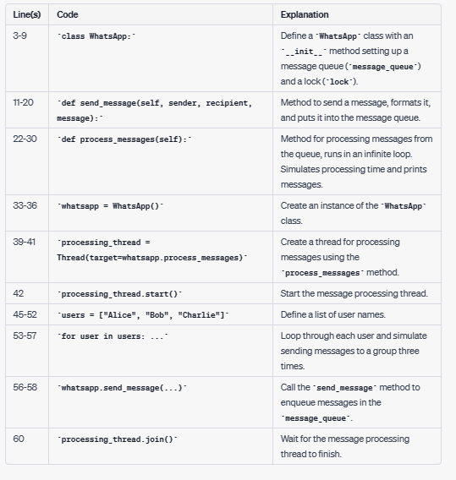
Explanation:

Slide 11
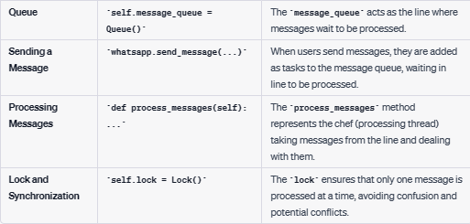
How these concepts used in the scenario:

Slide 12
Tasks:
Task 1: Queues and Message Passing
Implement a simple messaging system using queues for communication between threads.
Task:
Create a Python program that simulates a messaging system.
Implement two threads, one acting as a sender and the other as a receiver.
Use a queue to pass messages from the sender to the receiver.
Ensure proper synchronization to handle multiple messages correctly.
Display the received messages in the console.

Slide 13
Tasks:
Task 2: Implementation of Queues and Locks
Integrate the concepts of queues and locks in a more complex scenario.
Task:
Design a program that models a restaurant with multiple chefs and waiters.
Use queues to represent orders placed by customers and messages sent between chefs and waiters.
Implement locks to synchronize access to shared resources such as the kitchen or a list of orders.
Simulate the flow of orders, preparation by chefs, and delivery by waiters.
Ensure that the program runs smoothly in a multithreaded environment.

Slide 14
Task 3: Locks and Synchronization in a Banking System
Task:
Develop a Python program simulating a banking system with multiple customer accounts (represented as balances).
Implement multiple threads to perform transactions such as deposits and withdrawals on these accounts.
Without using locks, intentionally create a scenario where race conditions or data corruption can occur during concurrent transactions.
Run the program and observe the unexpected behavior resulting from the lack of synchronization.
Modify the program to use locks to ensure that only one thread can access an account for a transaction at a time.
Run the modified program and verify that the accounts are accessed safely without data corruption, ensuring the integrity of each transaction.
Output the final balances of the customer accounts to confirm that synchronization has been achieved.

